Slide 1
Professional Standards And MyPLN
Provided by the LAUSD Food Services Division
Notes:
TELL: Welcome to the Professional Standards training. Thank you for joining us here today. My name is _______________ .

Slide 2
Overview
The purpose of this training is to provide staff with instructions regarding USDA Professional Standards and Mandated School Program compliance guidelines pertaining to annual training procedures.
This training will focus on:
Mandated trainings
USDA requirements
Professional Development Brochure
Food Service Manager Responsibilities
MyPLN
Café LA website resources

Slide 3
Mandated Trainings
Annual mandated trainings provide Food Service Staff with the knowledge to run and operate food service programs in accordance with the USDA and CDE guidelines.
Standard Operating Procedure
Healthy, Hunger-Free Kids Act of 2010 (HHFKA)
Food Service Manager Responsibilities
MyPLN
Café LA website resources

Slide 4
USDA Required Training Hours
HHFKA requires a minimum amount of annual training hours for all staff that work within a USDA funded school nutrition program.
Program Directors | 12 Hours
Director | Regional Manager
HR Manager | Food Production Manager
Program Managers | 10 Hours
Food Service Manager | Senior Nutrition Specialist
Food Production Manager | Senior Meal Compliance Supervisor
Area Food Service Supervisor | Training Specialist
Nutrition Specialist | Senior Training Specialist
Program (Full-Time) Staff | 6 Hours
Food Service Senior Worker | Senior Office Technician
Food Service Worker | Secretaries
Food Service Worker II | Payroll
Food Production Assistant | Equipment Specialist
Food Production Worker | Food Services Staff Aide
Bldg & Grounds Worker | Graphic Designer II
Forklift Driver | Senior HR Representative
Packaging Worker | HR Representative
Senior Food Production Assistant | Meal Compliance Audit Clerk
Office Clerk | CMS (ITD)
Program (Part-Time) Staff | 4 Hours
Food Service Substitute Worker

Slide 5
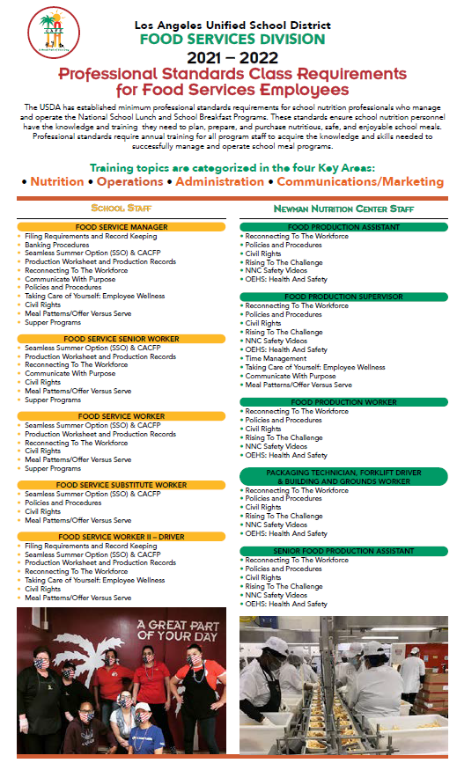
Professional Standards
Required training topic areas will vary according to each staff members job title.
The “Professional Standards Class Requirements for Food Services Employees” brochure outlines the specific trainings that must be completed each school year.
Located on the Café LA website - “Training and Resources” page.
Notes:
Business savvy leaders know that adding to your knowledge and skill set through professional development builds confidence and establishes credibility. Whether it’s a webinar on CEP fundamentals, a course on evaluation best practices or an online training about supper or offer vs serve, reinforcing your knowledge of Food Services programs sets you up to be the go to person for important answers.

Slide 6
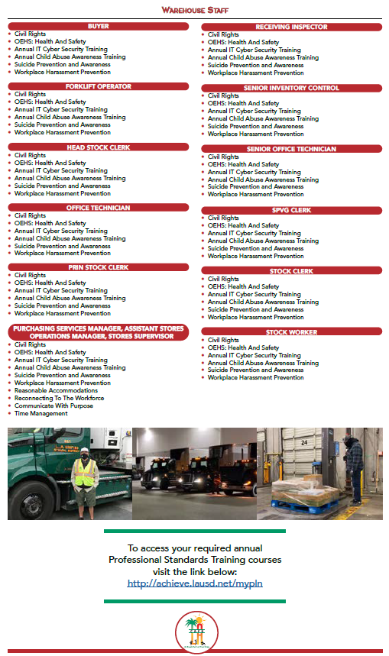
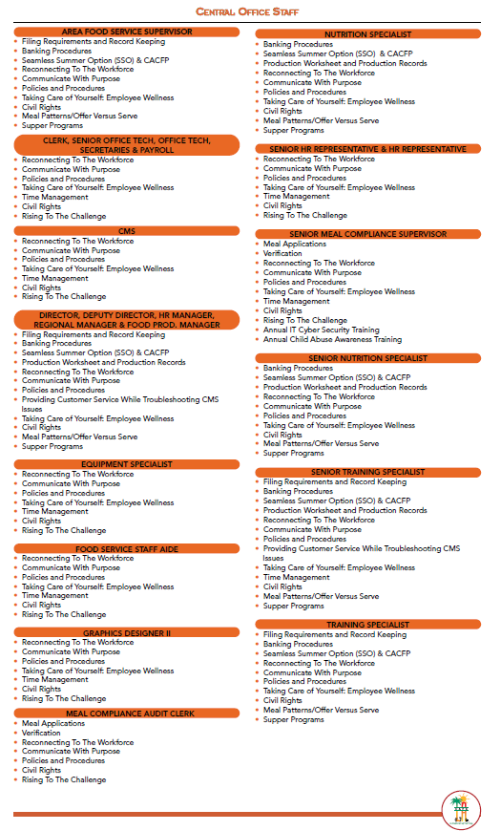
Professional Standards Brochure
Notes:
Business savvy leaders know that adding to your knowledge and skill set through professional development builds confidence and establishes credibility. Whether it’s a webinar on CEP fundamentals, a course on evaluation best practices or an online training about supper or offer vs serve, reinforcing your knowledge of Food Services programs sets you up to be the go to person for important answers.

Slide 7
Additional Mandated Trainings
Specific programs require training at the start of each school year and before a staff member can work within the program:
Child and Adult Care Feeding Program (CACFP)
Hot Supper
Cold Supper
Early Education Centers
Infant Centers
Snack Program
Summer Food Service Program Trainings (SFSP)

Slide 8
Instructor Led Trainings
Staff are offered an opportunity to attend instructor led trainings to complete a majority of required trainings.
New Employee Training (NET)
Manager Certification Course (MCC)
Annual Worker Orientation
Annual Manager Orientation
ServSafe Certification

Slide 9
My PLN
Annual trainings for the year are uploaded to the MyPLN platform and assigned to those employees that have not completed the required training hours.
Assigned by Central Office
Email notification when registered
Must watch entire training to receive completion
MyPLN will store training information for Central Office to track completed and non-completed annual trainings.

Slide 10
District Mandated Trainings
District mandated trainings are trainings provided by LAUSD via MyPLN tracking platform.
These include, but are not limited to: Suicide Prevention, Child Abuse Awareness, Reasonable Accommodations, Workplace Harassment.
Email notification when registered
Completion certificate issued
Manager collect certificates
File in individual employee file according to record retention requirements

Slide 11
Food Service Manager Responsibilities
Food Service Manager are required to monitor their cafeteria staff Professional Standards completion status.
Provide time during employee assigned work hours
Follow the training brochure to confirm all trainings are complete
To verify completion of MyPLN supper training, staff will visually provide the MyPLN completion certificate to the FSM

Slide 12
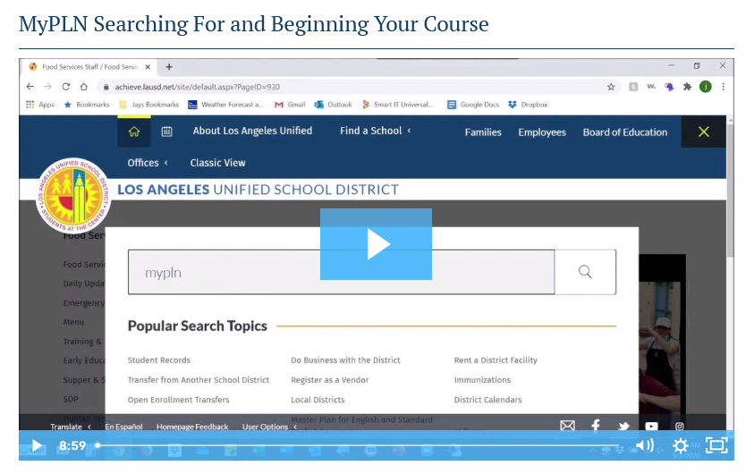
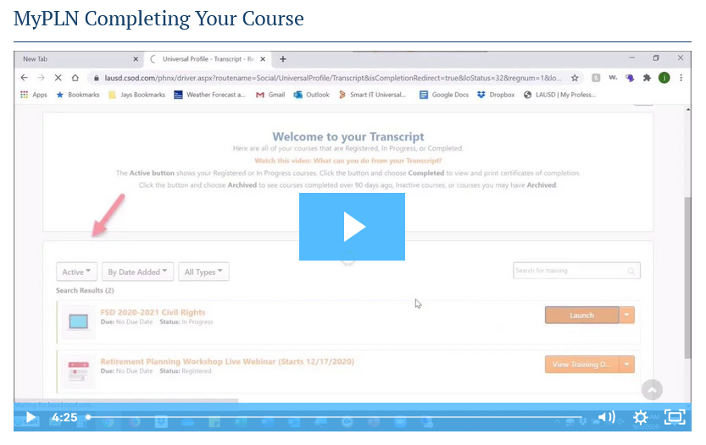
Website Video Resources
If staff needs assistance with My PLN refer to the Café LA website, Video Tutorial page.
MyPLN Searching For and Beginning Your Course
MyPLN Completing Your Course

Slide 13
Professional Development
Professional development enables individuals to
become more effective in the workplace, advance in their career and move into new positions where they can lead, manage, influence, and coach others.
YouTube; Ted Talk, Tech Talk, tutorials
MyPLN, ServeSafe, ICN, APEX Learning
District tuition reimbursement for classes related to your job class.
SEIU up to $600 per year
Teamsters up to $800 per year
Notes:
Professional development enables individuals to become more effective in the workplace, advance in their career and move into new positions where they can lead, manage, influence, and coach others.
Available resources;
YouTube; Ted Talk, Tech Talk, tutorials, etc.
MyPLN, ServeSafe, ICN, and APEX Learning
District tuition reimbursement for classes that are related to your job class.
SEIU receive up to $600 per year
Teamsters receive up to $800 per year

Slide 14
Questions?
LAUSD Food Services Division
Nourishing Children to Achieve Excellence
Notes:
TELL: Any Question? Thank you for attending today’s training.

